Slide 1
Slide 14
Namespace
Dasar-Dasar Pemrograman 1
Semester Ganjil 2016/2017

Slide 2
Scope
Recall that a namespace is a relation between names (variable name, function name, etc.) and objects
We use a namespace to determine what object is associated with a variable
There can be multiple namespaces
There is an order of search to look through different namespaces
There is an order of search to look through different namespaces to find a name. That process defines the scope rule in Python
If the entire sequence is examined and the name is not found, then Python returns an error
Dasar-Dasar Pemrograman Ganjil 2016-2017

Slide 3
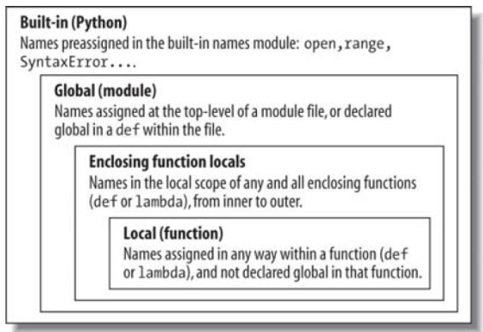
LEGB Scope Rule
The place in your code where a variable is assigned usually determines its scope
Dasar-Dasar Pemrograman Ganjil 2016-2017

Slide 4
Local Namespace
The local namespace is the namespace within a function that comes into being when the function is invoked, and it becomes inactive when the function invocation ends
While the local namespace is active, it is the first namespace that is checked for the existence of a name
If the name is found in the local namespace, then the associated object (or an error if no value is yet associated) is returned
Dasar-Dasar Pemrograman Ganjil 2016-2017

Slide 5
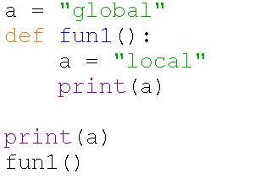

Example
Output:
Dasar-Dasar Pemrograman Ganjil 2016-2017

Slide 6
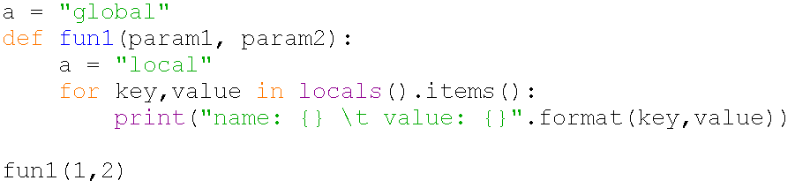

Special function: local()
The special function locals() takes no arguments and returns a dictionary of the local namespace
Output:
Dasar-Dasar Pemrograman Ganjil 2016-2017

Slide 7
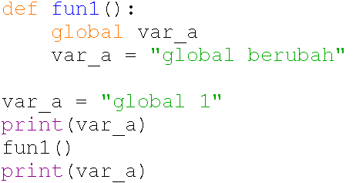

Changing global variables inside a Function
You can access a global variable in the module with keyword global
Output:
Dasar-Dasar Pemrograman Ganjil 2016-2017

Slide 8
Importing module
When the Python interpreter executes an import statement, it:
  Looks for the file corresponding to the module to be imported.
  Runs the module’s code to create the objects defined in the module.
  Creates a namespace where the names of these objects will live.
Dasar-Dasar Pemrograman Ganjil 2016-2017

Slide 9
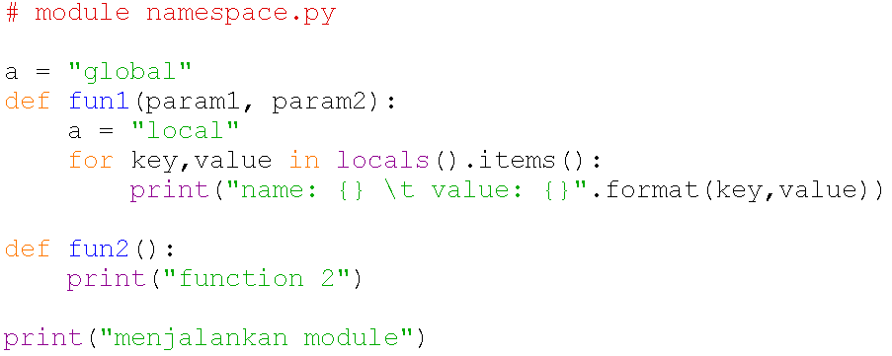
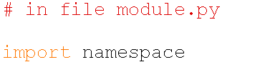

Example
Output:
Dasar-Dasar Pemrograman Ganjil 2016-2017

Slide 10
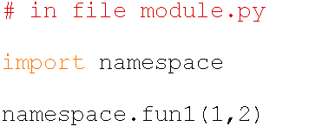
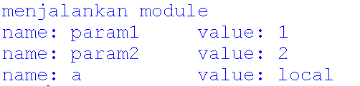
Example
Within namespace which has been created via import command, you can access functions and Classes inside the module via dot ( . ) calling
Output:
Dasar-Dasar Pemrograman Ganjil 2016-2017

Slide 11
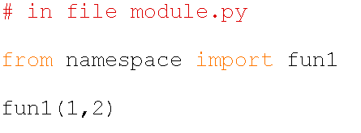
Calling specific module attributes
When just certain attribute(s) is needed, you can specify which attribute(s) you want to import with keyword from
When attribute(s) of a module is imported with from keyword, you can access it without dot ( . ) calling
Output:
Dasar-Dasar Pemrograman Ganjil 2016-2017

Slide 12
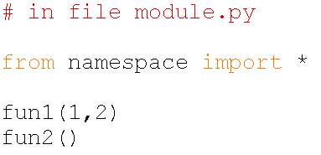
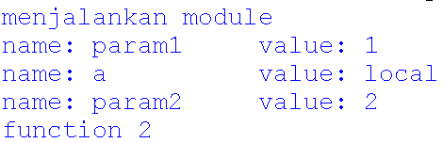
Calling specific module attributes
You can also import all attributes of a module and call it without dot ( . ) calling with asterisk (*) keyword after import keyword
Output:
Dasar-Dasar Pemrograman Ganjil 2016-2017

Slide 13
References
William Punch & Richard Enbody. The Practice of Computing using Python, 2nd Edition. Addison-Wesley, 2013
Y. Daniel Liang. Introduction to Programming Using Python. Prentice Hall, 2013.
John Zelle. Python Programming: An Introduction to Computer Science, 2nd Edition. Franklin, Beedle & Associates Inc., 2010.
Mark Lutz. Learning Python, 5th Edition. O’Reilly Media. Copyright 2013 Mark Lutz, 978-1-44-93-5573-9
L. Y. Stefanus. Slide Pelatihan Python. 2015.
Dasar-Dasar Pemrograman Ganjil 2016-2017

